Slide 1
Human and Machine Learning
Reflections on intelligence

Slide 2
Contents
Part 1
Definitions
The accidental story of how I got into ML…
Tips on Machine Learning
Demo 1 – Travel Insurance Claims
Part 2
Reflecting on Intelligence
Demo 2 – Text Generation
PS: Think of machine learning like a student learning at college …

Slide 3
Part 1

Slide 4
Definitions
Machine Learning
The scientific study of algorithms and statistical models that computer systems use to perform a specific task without using explicit instructions, relying on patterns and inference instead. (Wikipedia)
It is a subset of artificial intelligence.
Artificial Intelligence
Intelligence demonstrated by machines, in contrast to the natural intelligence displayed by humans. (Wikipedia)
Often used to describe machines (or computers) that mimic “cognitive” functions that humans associate with the human-mind, such as “learning” and “problem solving”.
Cognitive Functions
Multiple mental abilities, including learning, thinking, reasoning, remembering, problem solving, decision making and attention. (Gwenith & co. Theories of Cognitive Aging and Work, ScienceDirect)

Slide 5


Slide 6

Drew Conway – Data Science Venn Diagram

Slide 7
My Accidental ML Journey - Studies
Undergraduate – Electrical Engineering
Engineering Mathematics – Calculus, Linear Algebra
Information Theory
Programming (Fortran, C, Java, Assembly)
Human Resource, Sociology, Genes & Society, German
Final-Year Project – Bioinformatics System for Gene Diagnostics and Expression Studies
Probability and Statistics
Operational Research & Optimization
Knowledge-Based Systems
UNSW Summer School – Data Mining and Heuristics

Slide 8
My Accidental ML Journey - Actuarial
Graduate Diploma – University of Kent, Canterbury
Actuarial exams
More probability and statistics
Survival Models
Time Series
Stochastic Processes
Credibility Theory
Frequency-Severity models
Analyzing insurance data
Small number of claims (out of all policies sold)
Life insurance has very long time-frames – consider all possible outcomes
Catastrophes are rare – lack of data

Slide 9
Beyond Actuarial
AIA Singapore
NUS-ISS Python Programming and ML training
Andrew Ng’s “Machine Learning’ course on Coursera
Read!
Work
Analyzing ‘inactive’ customers
Predict product categories agent will sell (based on historical sales)
Prototype food recognition system (Inception V3, transfer learning)
Data Analytics Project Framework
Data Analytics Capability-Building Framework
Skills framework for data analysts
Practise Day
Training my intern…

Slide 10
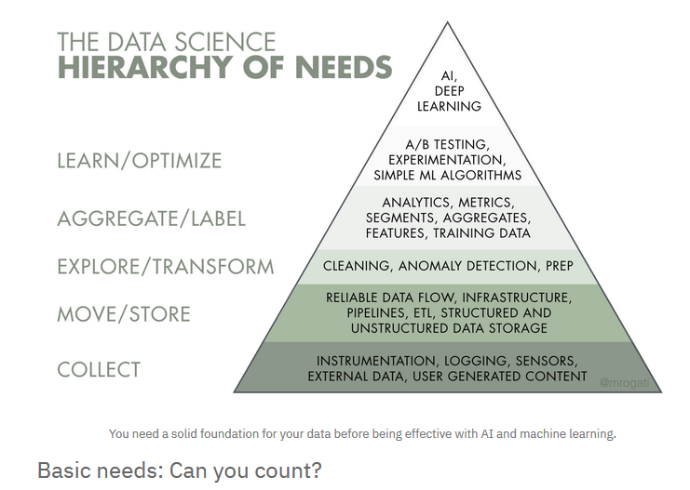
Data Science Hierarchy of Needs

Slide 11
Tips on Machine Learning
Identify the problem statement / hypothesis
Is it a problem that requires machine learning or something else?
Is the data required to solve the problem available?
Data Engineering
Data quality, cleaning
Data understanding and exploration
BEWARE BIAS IN DATA!!
Data augmentation – 3rd party sources
Feature Engineering
Modify or combine the data so that an algorithm can learn better
Some algorithms can do this by themselves

Slide 12
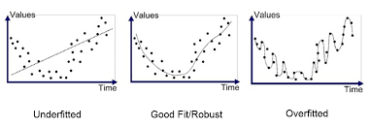
Tips on Machine Learning
Algorithms
For a fresh new problem, we don’t know which algorithm works best
Simple algorithms tends to take less data, time and effort to train (start with these)
Tends to provide explanations – descriptive statistics, decision trees
Tends to underfit
Affects the data stories that we tell

Slide 13
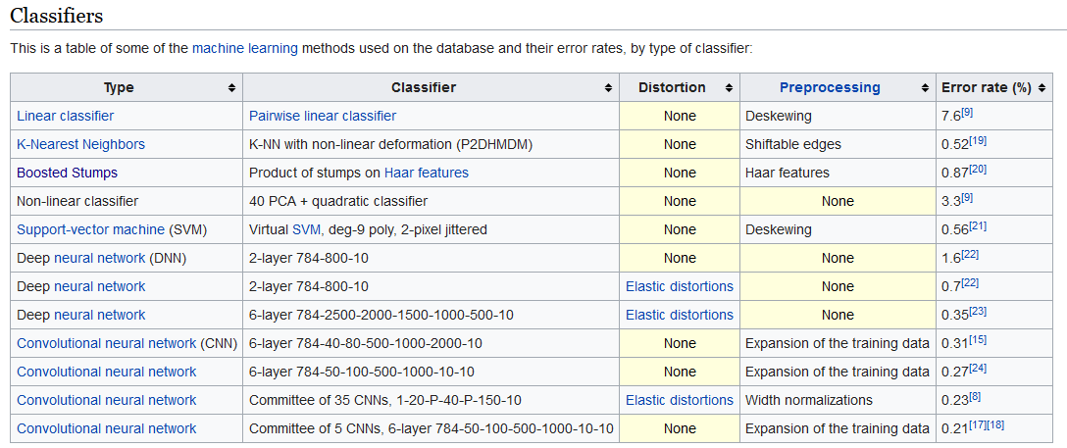
Tips on Machine Learning
Simple algorithms can capture significant benefits (compared to complex algorithms)
MNIST Database - Wikipedia

Slide 14
Tips on Machine Learning
Failure is not an option – it will happen (rather often)
If it is a fresh new problem, you will need to test several algorithms
Sometimes, your algorithm will still fail to learn
Poor data, poorly tuned hyperparameters, unsuitable algorithm
Close the loop
Insights from machine learning must be put into Business Action
Measure the outcomes of the Business Action (including side effects)
Evaluate effectiveness and take the next step
Beyond Machine Learning
Systems Thinking, Game Theory, Design Thinking (esp. important on Business Action aspect)
Communication – Explaining the model, comparing the metrics/outcomes, visualizations
Context, psychology and human behaviour
Gamification
Incentives
Nudges/Reminders

Slide 15
Demo 1

Slide 16
Part 2
Reflections on intelligence

Slide 17
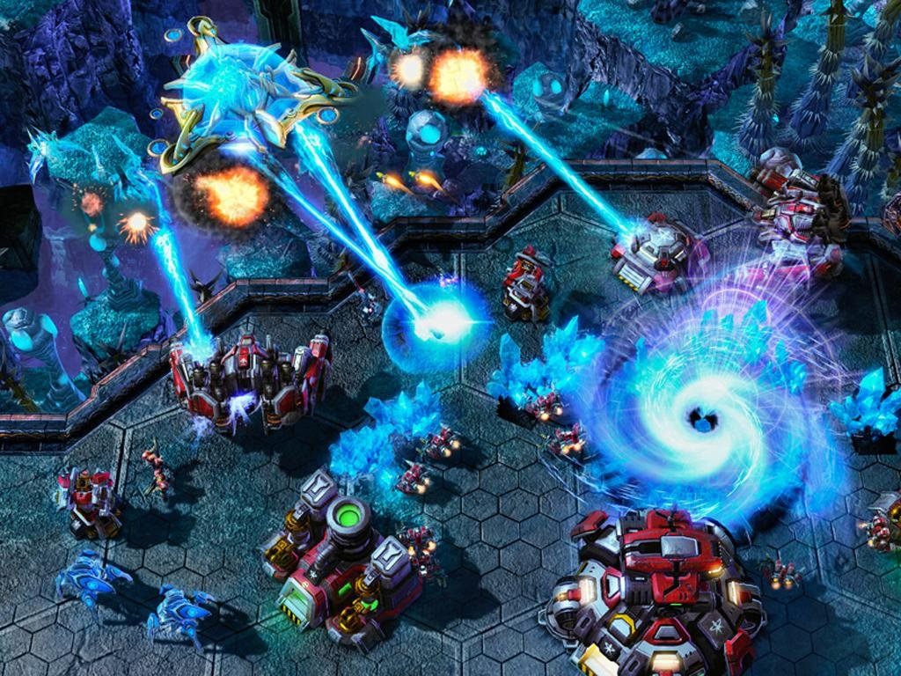

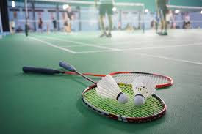

I grew up playing games …

Slide 18
I grew up playing games…
Artificial and human opponents
Players do not follow a strict sequence of actions
Random ‘start’ points
Preference for certain strategies
Reacting to limited/available information
Cooperation and/or competition
Decisions on how much to bet or payoff
Understand rules, objectives, context
Resource constraint
Chance/luck
Bluff
Learning feedback loops are closed.
Play with diverse opponents / scenarios
Play
Outcome: Win/Lose
Learn
Search for tips / techniques to improve game

Slide 19
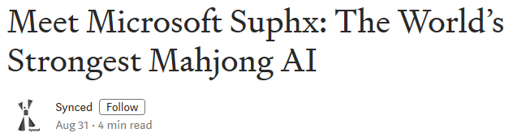
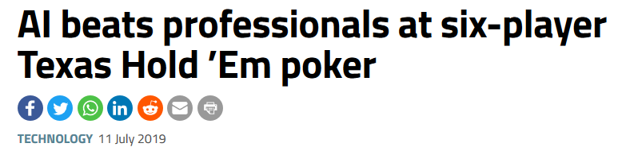
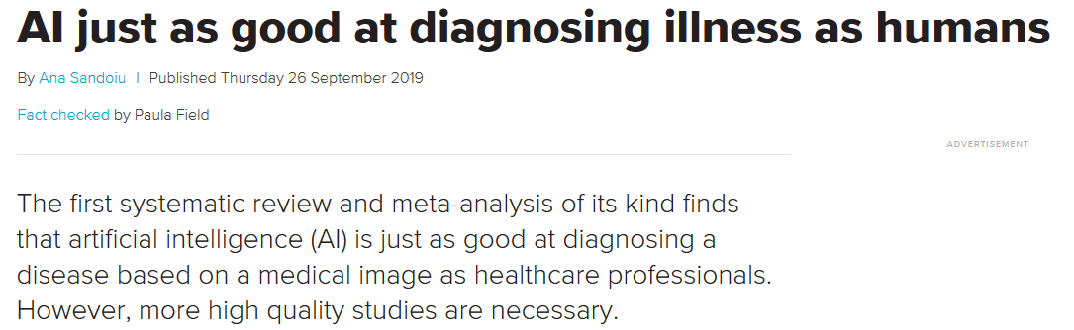
These days, AI kicks our ass!

Slide 20

AI can identify associations from large amounts of news data
Word2Vec

Slide 21
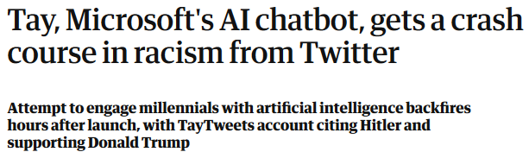
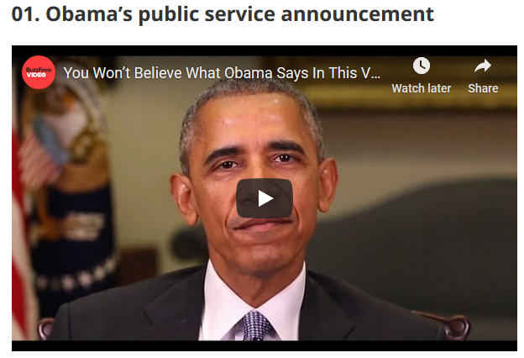
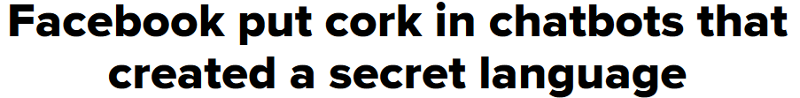
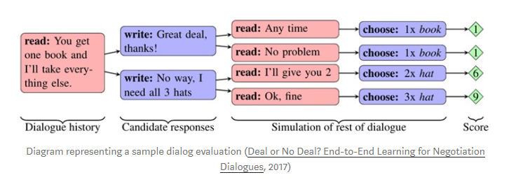
But AI can also be ‘stupid’ and dangerous …
DeepFake

Slide 22
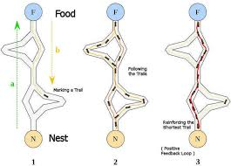
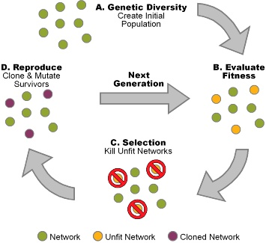
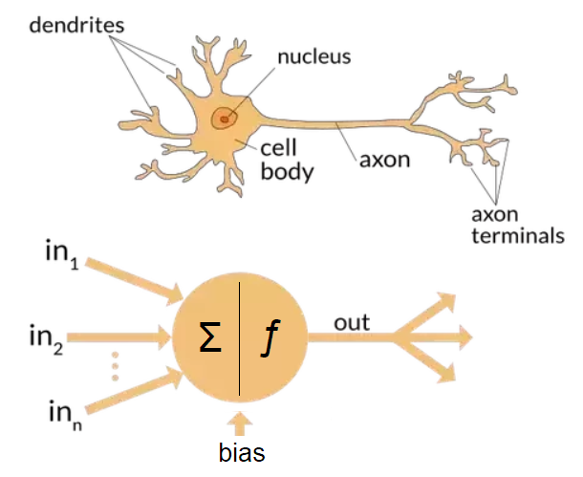
Human and Nature inspires various ML Algorithms
Swarm Intelligence – Ant Colony Optimisation
Genetic Algorithms
Neural Networks

Slide 23
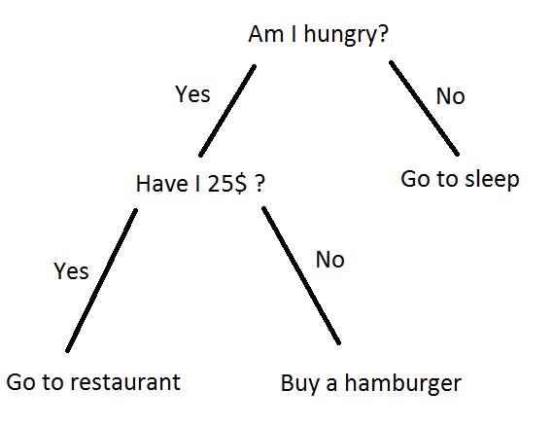

ML Algorithms inspires Mental Models of Human Behaviour and Thinking
Decision Tree

Slide 24
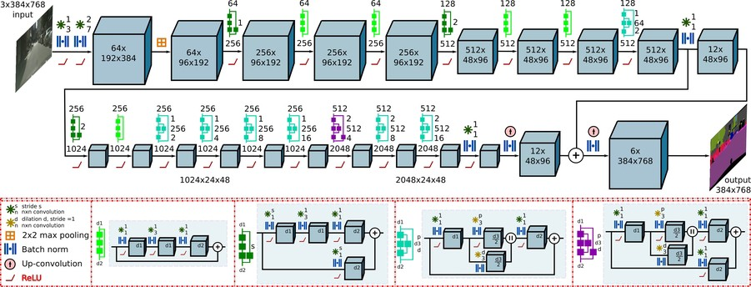


ML Algorithms inspires Mental Models of Human Behaviour and Thinking
Convolutional
Neural
Network

Slide 25
Is human communication just the transmission and discussion over mental models?
Yes, it’s a pretty simple decision tree.
Decision Tree

Slide 26
Convolutional
Neural
Network
The answer is “Yes” or “You look pretty in it”.

Slide 27
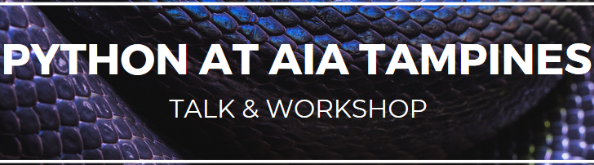
ML Algorithms inspires Mental Models of Human Behaviour and Thinking
Transfer Learning:
Takes less effort and time
Change your brain’s compiler “source language”
Underlying concepts stays the same
Retraining your neural weights by coding along
Participants can do these in language X:
Variables, Operators
Conditional Statements, Loops
Functions
Object-orientation
Data structures
Now do it in Python!:
Highlight how to do it
Highlight differences
Highlight additional Python features
Provide relevant examples

Slide 28
ML Algorithms moulds our Mental Models of Human and Artificial Intelligence
What I’ve learnt from experienced machine learning practitioners
They think “for” their algorithms
Good understanding how various algorithms work
Know the type of data required, how it should be ‘featured’ – scaling, normalise
Knows how to configure/design algorithms and tune them
layers in a neural network (ie. control underfit and overfit)
Dropout rate (ie. random ‘forgetting’ of data)
Batch sizes (ie. amount of data to feed before evaluating)
Learning rate (ie. how fast to adapt to evaluation)
Self-motivated learners
They have to be to keep up with the field
Crack ML jokes about their bosses and colleagues

Slide 29
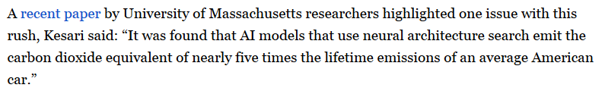
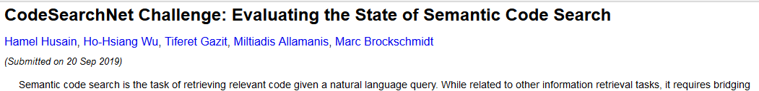
Living in an intelligent world
AI is performing at higher levels than humans at various cognitive tasks.
How do you feel about that?
AI/ML vs human on energy consumption
Github’s CodeSearchNet Challenge
Watch out, Stack Overflow!

Slide 30
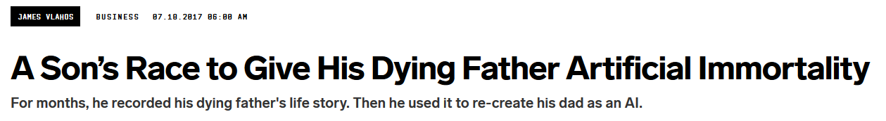
Living in an intelligent world
In an office where workflows are digitised and automated, would an AI eventually be trained to identify suitable humans for whatever roles would enhance its corporate function?
Not just to analyse CVs
Gamified hiring process where we create a ‘corporate game’ simulation for potential hires to play (ie. can be both employee or adversarial)
Applying ‘Ensemble’ technique to create a ‘committee’ of humans to make decisions.
Artificial Immortality

Slide 31
Demo 2
Let me start the demo, and as it runs, you can ask questions.

